Slide 1


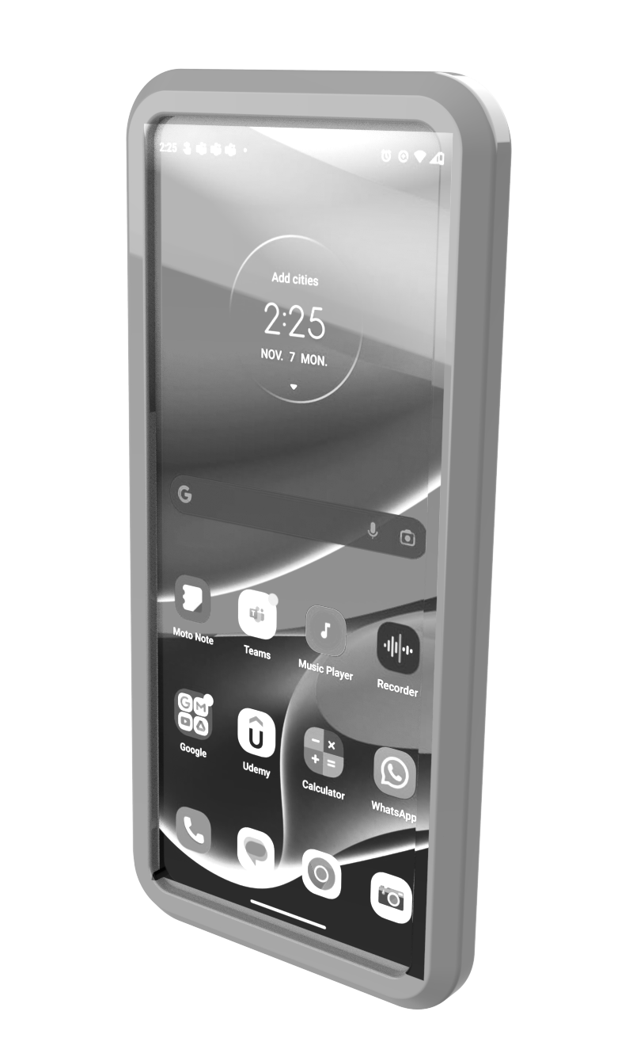
Battery Monitoring System
Cloud Service
AH<9

